Slide 1
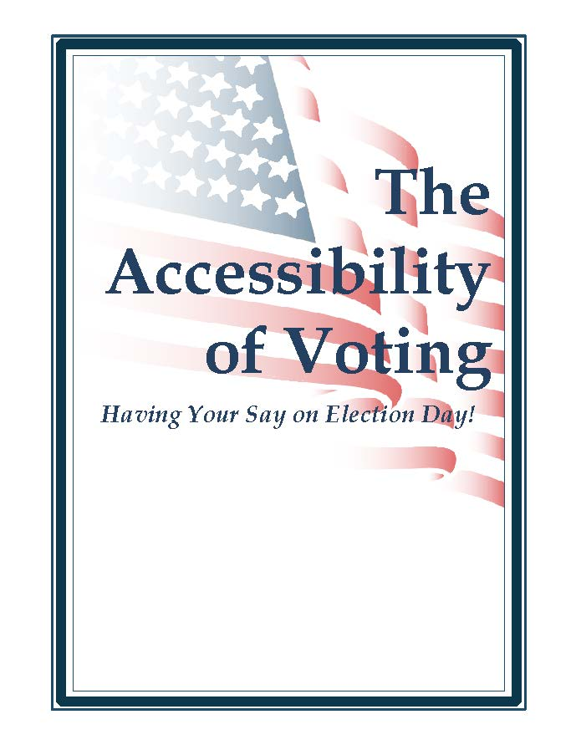








Topics:
  Registering to Vote
  Absentee Voting
  Voting on Election Day
  Contacting Your Registrar

Slide 2




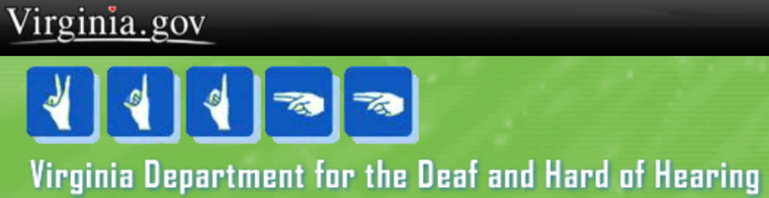



The Accessibility of Voting
Having Your Say on Election Day
Registering to Vote
Designated State Agencies
These state agencies are mandated by federal and state law to provide the opportunity to apply to register to vote to their clients: Dept. of Health; Dept. of Social Services; Dept. of Aging & Rehabilitative Services; Dept. for the Deaf and Hard of Hearing; Dept. for the Blind and Vision Impaired; Dept. of Behavioral Health and Developmental Services; Virginia Office for Protection and Advocacy ; Virginia Centers for Independent Living; Armed Forces Recruitment Offices
SBE provides agency appropriate training to ensure agency compliance:
Garry E. Ellis
1100 Bank Street, 1st Floor ,Washington Building
Richmond, VA 23219
Phone: 804-864-8910 Fax: 804-371-0194
Toll Free: 800-552-9745
Email: garry.ellis@sbe.virginia.gov

Slide 3
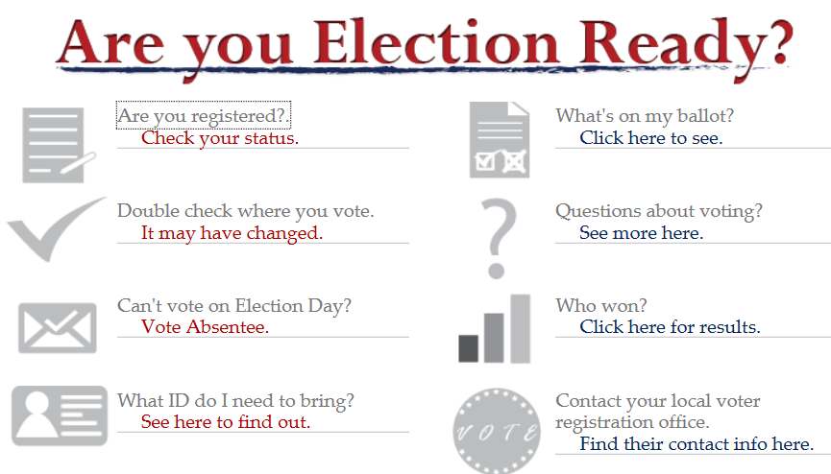
The Accessibility of Voting
Having Your Say on Election Day
Registering to Vote
  Voters may register on line if they have a Virginia DMV record
  Virginia State Board of Elections
  http://www.sbe.virginia.gov/
Notes:
You may register on line, or change your current voter registration information, if you have a record at Virginia DMV
Navigate to the SBE web site
Select Check your status
Follow the instructions and prompts.
Other registration and election information is available through the links provided
Locate your polling place
See what is on your ballot
Check election results
Get information on absentee voting
Find your local voter registration office
If you assist someone, make sure they are available to respond to, and acknowledge, security prompts.
If the individual does not have a DMV record, the system will prompt to complete an application that can be printed, signed and mailed to the GR

Slide 4
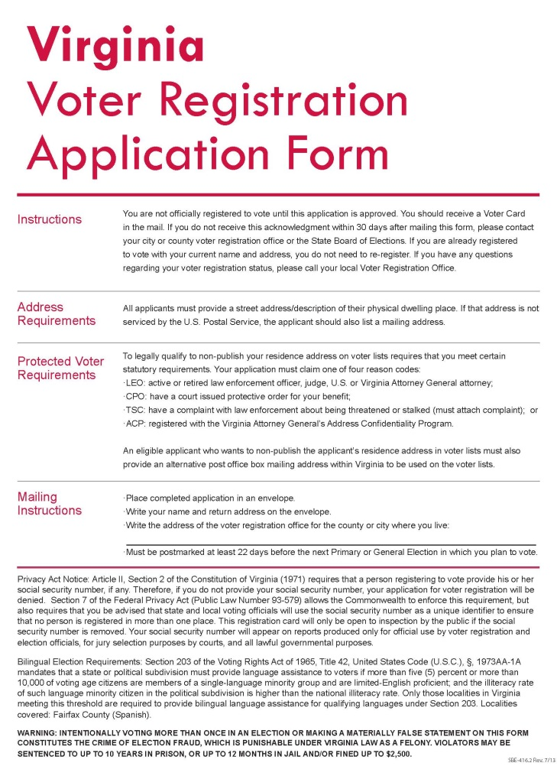
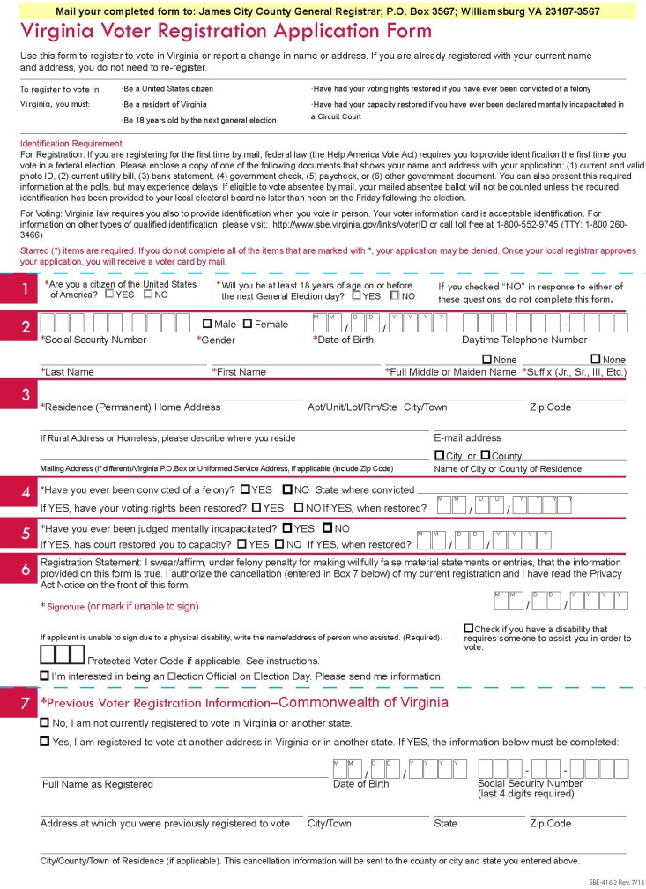
The Accessibility of Voting
Having Your Say on Election Day
Registering to Vote
Voters without DMV records may register on paper
Forms are available:
SBE’s On Line link will offer an opportunity to create and print an application if there is no DMV record
On Line at SBE or GR web sites
By Mail from GR
In Person from GR or other locations – check with your local GR
Notes:
An attempt to register on line without a DMV record will result in an offer to create and print an application that can be mailed to the GR. An electronic notice of intent to submit will be sent to the GR; follow up by completing, signing and mailing the application to the GR

Slide 5
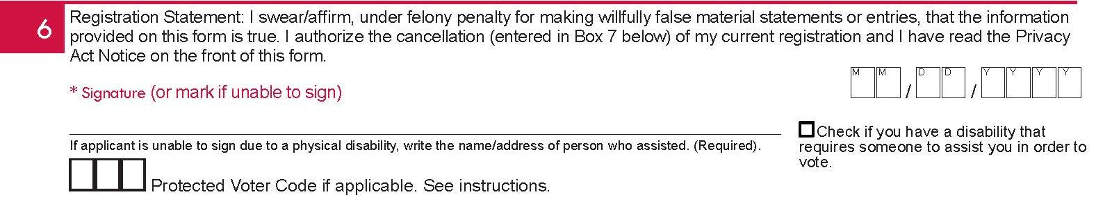
The Accessibility of Voting
Having Your Say on Election Day
Registering to Vote
Voter Registration Assistance
X
Thomas Swift; 914 Swingline Dr; Everly MN 81332
Section 6 of the voter registration application is the sworn statement, by the registrant, that the information provided is true. If the registrant is unable to sign, they may make a mark and the information for the assistant must be provided.
Checking the disability checkbox alerts the GR that assistance will be required to vote.
Notes:
Section 6 of the voter registration application is the sworn statement by the registrant that the information provided is true. If the registrant is unable to sign, they may make a mark. The information for the assistant must be provided.
Checking the disability checkbox alerts the GR that assistance will also be required to vote.

Slide 6
The Accessibility of Voting
Having Your Say on Election Day
Registering to Vote
Deadlines Apply!
Voter registration books are closed during the 21 days preceding a general or special election
Applications received, or postmarked, by the deadline date will be processed for the current election.
Applications received, or postmarked, after the deadline will be processed following the election and will be effective for the next following election.
Incomplete applications may be denied and replacement applications must meet the current deadline.
Other deadlines may apply to the closing of
voter registration books preceding special elections
Notes:
Failure to report changes in voter registration may affect eligibility to vote!

Slide 7
The Accessibility of Voting
Having Your Say on Election Day
Absentee Voting
Absentee Voting provides voters that will not be able to go to the polls on Election Day an opportunity to vote before election day
Voters must meet one of the 19 reasons provided in law
Voting may be performed in person or by mail
Begins 45 days before Election Day
Deadlines Apply
  In Person final day – Saturday before the Election
  By Mail final day – application must be received by GR Tuesday before Elections; ballot must returned by close of polls on Election Day
All valid absentee ballots are counted in Virginia
Notes:
Student; Spouse of student; Business; Personal Business or Vacation; Work/Commute 11 or more hours; First Responder; Disability or Illness; Primary Care Giver (family member at home); Pregnancy; Confined Awaiting Trial; Confined, Convicted of Misdemeanor; Electoral Board, GR, OE, Equipment Custodian; Religious Obligation; Active Duty Merchant Marine or Armed Forces; Spouse of; Temporarily residing outside U.S.; Temp outside U.S. for employment or spouse; Pres/Vice Pres Only; Authorized Rep of Candidate or Party serving inside the polling place.

Slide 8
The Accessibility of Voting
Having Your Say on Election Day
Absentee Voting
Two Different Forms for Requesting Absentee By Mail
Standard Virginia Absentee Ballot Application (Form 701)
  Voter must complete a different form for each election
  Voter may designate an alternate ballot mailing address
  Application MUST be received by the issuing locality by 5 p.m. on the Tuesday before Election Day
  Ballot is sent after application validation and acceptance
  Ballot MUST be returned to the issuing locality by 7 p.m. on Election Day

Slide 9
The Accessibility of Voting
Having Your Say on Election Day
Absentee Voting
Two Different Forms for Requesting Absentee By Mail
2. Annual Absentee Ballot Application (Form 703.1)
  For use by a voter with an ongoing disability or illness
  Valid for every election during Jan 1 – Dec 31 calendar year
  Includes party primary elections if party designation marked
  First application requires signature of licensed physician, disability services provider or accredited religious practitioner
  Renewal application sent to voter each Dec must be returned to continue service but doesn’t need doctor signature
  Ballot automatically sent to voter; MUST be returned to the issuing locality by 7 p.m. on Election Day

Slide 10
The Accessibility of Voting
Having Your Say on Election Day
Absentee Voting
Assisting Absentee Voters
If a voter requires assistance to fill out an application, the “Assistant’s Statement” section of the form must be completed
2. If a voter requires assistance to complete a ballot, a separate
“Request for Assistance” form must be used
  In person voting, the form is completed before ballot issue
  By Mail voting, the form is sent with the ballot and must be completed and returned with the ballot. Special instructions apply and are included with the ballot.

Slide 11

The Accessibility of Voting
Having Your Say on Election Day
Voting on Election Day
Accessible Facilities
§ 24.2-310. Requirements for polling places
C. Polling places shall be accessible to qualified voters as required by the provisions of the Virginians with Disabilities Act (§ 51.5-1 et seq.), the Voting Accessibility for the Elderly and Handicapped Act (42 U.S.C. § 1973ee et seq.), and the Americans with Disabilities Act relating to public services (42 U.S.C. § 12131 et seq.).

Slide 12
The Accessibility of Voting
Having Your Say on Election Day
Voting on Election Day
  Accessible Equipment
The actual type of equipment in use may vary from locality to locality, but each and every polling place in every locality will have one piece of voting equipment that meets this legal requirement:
§ 24.2-626.1. Acquisition and use of accessible voting devices.
“. . . at least one voting system equipped for individuals with disabilities at each polling place, including nonvisual accessibility for the blind and visually impaired, in a manner that provides the same opportunity for access and participation (including privacy and independence) as for other voters . . .”

Slide 13
The Accessibility of Voting
Having Your Say on Election Day
Voting on Election Day
Curbside Ballot; Car Ballot; Outside Polls Ballot
Although the lingo may vary locality to locality, the law is the same:
§ 24.2-649. Assistance for certain voters.
  A. Any voter age 65 or older or physically disabled may request and then shall be handed a paper ballot or a mark sense ballot by an officer of election outside the polling place but within 150 feet of the entrance to the polling place.

Slide 14
The Accessibility of Voting
Having Your Say on Election Day
Voting on Election Day
Voter Assistance Inside the Polling Place
§ 24.2-649. Assistance for certain voters.
B. Any qualified voter, who requires assistance to vote by reason of physical disability or inability to read or write, may, if he so requests, be assisted in voting. If he is blind, he may designate an officer of election or any other person to assist him. If he is unable to read and write or disabled for any cause other than blindness, he may designate an officer of election or some other person to assist him other than the voter's employer or agent of that employer, or officer or agent of the voter's union.

Slide 15
The Accessibility of Voting
Having Your Say on Election Day
Contacting Your Voter Registrar
City of Williamsburg – Win Sowder
Municipal Building, 401 Lafayette St
P.O. Box 3538; Williamsburg, VA 23187-3538
Phone: 757-220-6157
Fax: 757-220-6158
Email: wsowder@williamsburgva.gov
City of Newport News – Vicki V. Lewis
2400 Washington Avenue
Newport News, VA 23607
Phone: 757-926-8683
Fax: 757-926-3653
vlewis@nngov.com
James City County – A.J. Cole, Sr.
101B Mounts Bay Road
P.O. Box 3567; Williamsburg VA 23187-3567
Phone: 757-253-6868
Fax: 757-253-6875 TDD: 711
Email: vote@jamescitycountyva.gov
City of Hampton – Tara Morgan
1919 Commerce Dr. Suite 280
Hampton, VA 23666
Phone: 757-727-6218
Fax: 757-727-6084
Email: tmorgan@hampton.gov
York County – Walt Latham
224 Ballard Street
P.O. Box 451; Yorktown, VA 23690
Phone: 757-890-3440
Fax: 757-890-3449 TDD: 757-890-3300
Email: registrar@yorkcounty.gov
City of Poquoson – Tammi Pinckney
500 City Hall Avenue
Poquoson, VA 23662
Phone: 757-868-3070
Fax: 757-868-3104
Email: Tammi.Pinckney@poquoson-va.gov

